Slide 1

Housekeeping
Module 10 – Ending the Relationship
Please mute yourself if you are not speaking.
Feel free to include your pronouns in your Zoom Name.
Use Zoom reaction tools, chat box, hands up, etc.
Be prepared to have video on at all times; as such, please be appropriately dressed and limit distractions.
Contribute to the conversations out loud and in the chat box.
If someone has already shared what you were going to say, lower your hand and put “agree” in the chat.
Notes:
COORDIANTOR
Read out Housekeeping slide.

Slide 2
Expectations
Module 10 – Ending the Relationship
Arrive on time.
Help us create a confidential, non-judgmental space (no screenshots or recordings).
Please keep your phones on silent.
Avoid cross-talk and side-talk.
Learn from each person’s perspective.
Language – please bring new language to us as we recognize that language is ever-changing.
Have fun!
From the group:
[ADD PARTICIPANT ADDITIONS, IF ANY]
Notes:
COORDINATOR
Read out Expectations slide.

Slide 3
Ending the Relationship
Module 10
Notes:
Trainer Manual
Module 19: Ending the Relationship – a Core Peer Support Skill © 2023 PeerWorks
This training program is designed to be accessible to all trainers, and ensure that all participants receive the same quality of education regardless of specific trainers’ background and experience.
This manual is a living document and should be understood as a set of guidelines, not as a fixed script. Feel free to adapt the language to your style of presentation. We also recognize that language is always changing; please update terminology when necessary. The synchronous sessions should be dynamic, engaging experiences.
TRAINER
Welcomes everyone and states the topic of today’s module.

Slide 4
Land Acknowledgement
Module 10 – Ending the Relationship
[ADD TRAINER’S LAND ACKNOWLEDGEMENT HERE]
Notes:
TRAINER’S LAND ACKNOWLEDGEMENT

Slide 5
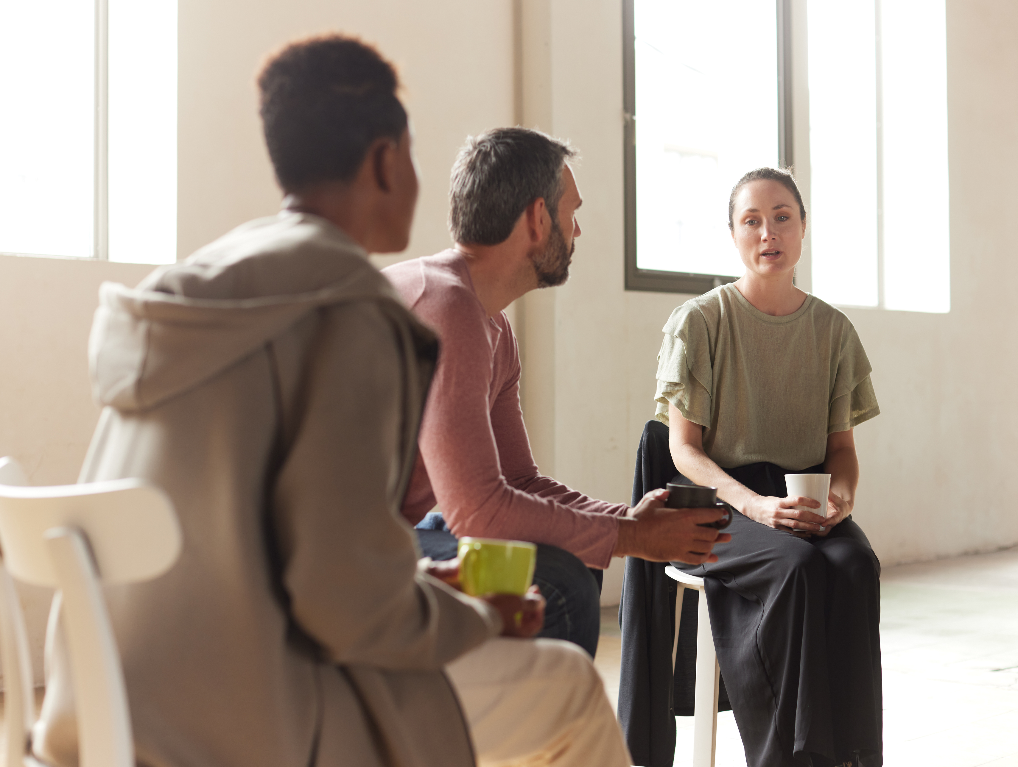
Icebreaker Activity
Module 10 – Ending the Relationship
What is your name?
If you could have lunch with one person, who would it be?
(Dead or alive. Real or fictional).
Notes:
TRAINER
“If you could have lunch with one person, who would it be? (Dead or alive, real or imagined.)”
As the trainers, feel free to go first. Keep it brief and thank people for sharing.
After everyone has answered the question, move to the group check-in.

Slide 6
Group Check-In
Notes:
TRAINER
Ask about the reflections that people have completed for this class. How was their experience sharing? What came naturally and in what areas do they still require work?
This slide is a placeholder for a group check-in. Feel free to read the following script, or just ask the participants how they are doing in your own words.
“Over the last two modules, we have begun developing the skills of Listening and Sharing. As with most skills, our comfort and confidence in Listening and Sharing will increase the more we practice, and there will be more opportunities to practice throughout the rest of the program.
Right now, we just want to take a moment to check in and see how everyone is feeling after the initial shares and offer the space to share or ask questions.”

Slide 7
Module Overview
Module 10 – Ending the Relationship
In Module 10, we will discuss the end of a Peer Support relationship. This will include practical ideas for discussing the end with your peers and communities of practice.
Though not all Peer Support relationships will have clear endings, it is always beneficial to take time to reflect on the relationship and the lessons you will carry forward.
Notes:
TRAINER
Read the Module Overview and Learning Objectives out loud or invite a participant to read it out loud.

Slide 8
Learning Objectives
Module 10 – Ending the Relationship
Through the successful completion of Module 10, you will have the skills and knowledge to:
End a Peer Support relationship in a mutually beneficial way.
Reflect on the experiences shared during the relationship.
Find a Peer Support community of practice to share and learn from while respecting the confidentiality of your peer support relationship.
Notes:
TRAINER
Read the Module Overview and Learning Objectives out loud or invite a participant to read it out loud.

Slide 9
Concluding the Relationship
Module 10 – Ending the Relationship
Concluding the Relationship is bringing closure to a Peer/Peer Supporter relationship. This can involve:
Acknowledging the end of the formalized relationship between the Peer and the Peer Supporter.
Assisting the Peer during the transition between the conclusion of the formalized Peer/Peer Supporter relationship and the Peer’s next step.
Reflecting on the lessons learned from the relationship between the Peer and the Peer Supporter.
Notes:
TRAINER
Today we are going to talk about Concluding the Relationship. This slide introduces the focus of today’s session. Read out the slide, or ask someone to read it out.

Slide 10
Acknowledging the End of the Relationship
Module 10 – Ending the Relationship
There are many different ways that the relationship may end:
Peer has received the needed and desired support from Peer Supporter.
Service offered by the Peer Supporter has concluded.
Peer no longer wishes to connect with Peer Supporter within a Peer/Peer Supporter relationship.
Peer is unavailable to continue participating in Peer/Peer Supporter relationship.
Other life circumstances or situations experienced.
Notes:
TRAINER
This slide discusses the first part of Concluding the Relationship: Acknowledging the End of the Relationship.
Ask the participants to suggest some reasons why the relationship might end. When you click the space bar, some examples will appear. However, start with the participants’ ideas and invite them to share why their previous Peer Relationships have ended.

Slide 11
Scenario
Module 10 – Ending the Relationship
You have been working with Charley for several months and you’ve created a strong Peer Support relationship and have shared personal lived experiences with each other.
However, your position at your organization has just changed and you will no longer be working in one-on-one Peer Support.
How do you break the news to Charley?
.
Complication: Charley is really upset by the news, and states that he feels “abandoned”.
Notes:
TRAINER
Ask a participant to read out the scenario. Once the group has discussed the scenario, press the space bar and a “complication” will appear. How does this affect the scenario?

Slide 12
Assisting the Peer During Transition
Module 10 – Ending the Relationship
The ending of a relationship between a Peer and a Peer Supporter is a time of change for both the Peer and the Peer Supporter.
A Peer Supporter may support the transition by:
Acknowledging the Adjustment
Clarifying Next Steps
Instilling Confidence
Notes:
TRAINER
Read out the slide and, if necessary, expand on the points listed.
For instance: “acknowledging the adjustment” can be as simple as saying “We are reaching the end of our relationship and I’m happy that I got the opportunity to get to know you.”

Slide 13
Scenario 2
Module 10 – Ending the Relationship
You have been working as a Peer Supporter with a Peer named Mei. You both belong to many of the same communities and have similar personal experiences. Your relationship has reached its natural conclusion, and Mei asks if you would like to stay in touch.
How do you respond to Mei’s question?
What if you don’t feel comfortable staying in touch?
Notes:
TRAINER
This is the second scenario that you can go through as a group. Once the group discusses the scenario, click the space bar and the “complication” will appear.
Notes to bring up:
Refer to the organization’s guidelines.
It is your choice. There is nothing wrong with staying in touch or not staying in touch.
If you do not want to stay in touch, you can state that you like to keep your personal life and Peer Support work separate.
Ending a relationship can be more difficult in informal Peer Support settings where the lines between friendship and Peer Support are more blurred.
If you do not want to stay in touch, you can still reiterate how the Peer Relationship has benefited you.
You should be halfway through the allotted time.

Slide 14
Reflecting on the Experience
Module 10 – Ending the Relationship
Reflecting on experiences allows one to consider how the Peer and Peer Supporter have grown through the relationship.
This may include:
Acknowledging areas of growth.
Sharing lessons learned.
Celebrating Peer Support
Notes:
TRAINER
Invite a participant to read the slide.
Notes to bring up:
This can be a written reflection done with your Peer, or it can be an informal conversation.
You can also discuss how you and your Peer will use the “lessons learned” in Peer Support in other areas of your life.

Slide 15
Small Group Discussion
Module 10 – Ending the Relationship
Together consider and discuss:
What has eased your transition when relationships you have participated in have concluded?
What are the ways that you have grown through your relationships with Peers?
What are you carrying forward from these relationships?
What will you bring into your next relationship as a Peer Supporter?
Notes:
COORDINATOR
This slide explains the next activity, which is a small group discussion.
Once the group has had time to discuss their answers to the question. Bring the groups back together and ask if there is anything people want to share with the entire group.

Slide 16
Communities of Practice
Module 10 – Ending the Relationship
A Peer Support community of practice is a group of people who share a concern and passion for peer support and learn how to do it better as we interact regularly.
CoPs often focus on sharing best practices and creating new knowledge to advance a domain of professional practice. Interaction on an ongoing basis is an important part of this. A community’s specific purpose and goals inform the appropriate activities and technologies to support it. Many virtual communities of practice rely on face-to-face meetings and Web-based collaborative environments to communicate, connect, and conduct community activities.
Notes:
TRAINER
This slide introduces Communities of Practice to the group. Some people might have heard of and even participated in these CoPs before, while it might be a completely new experience to others.
Notes to bring up:
PeerWorks has CoPs for their members/member organizations.
Your organization might have their own CoPs that you can join.
The group discussions that we have in these modules allow us to reflect and learn from our own experiences and those of fellow peers. We can continue these discussions throughout our Peer Support careers with Communities of Practice.
A training group can become a CoP through FB/Discord
Topics that may be covered in CoPS: a specific challenge that came up or something general, such as supporting peers through transitions
CoPs are different than Debriefing, which we will talk about in more detail in Module 11 on Crises

Slide 17
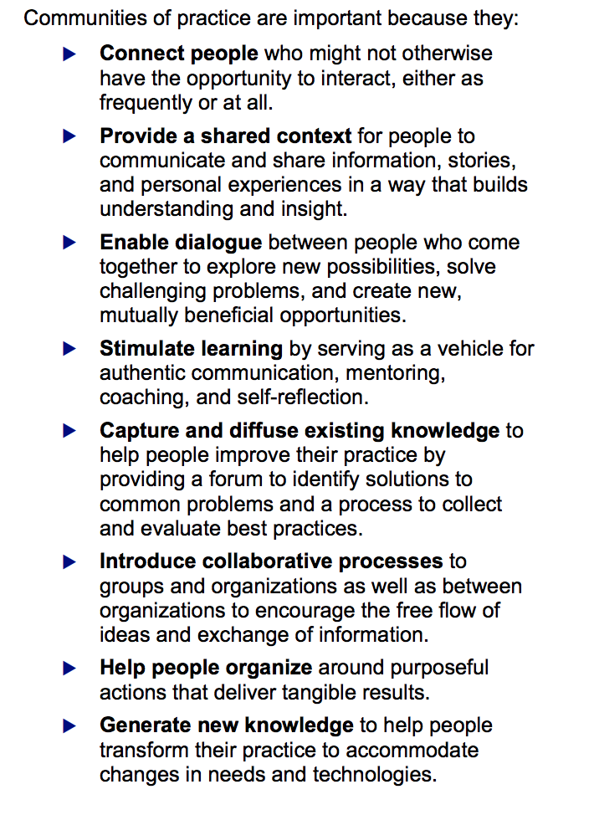
Michael Smith Foundation for Health Research
Guide for Communities of Practice
Notes:
TRAINER
Go through the slide with the participants, which describes benefits of a CoP.
Are there any other things that are missing from this slide? This list is taken from the Michael Smith Foundation for Health Research’s Guide for Communities of Practice. This list can also be found in the Resources section of your Homework.

Slide 18
Group Discussion
Module 10 – Ending the Relationship
Consider the scenarios we discussed earlier when Charley felt “abandoned” by the Peer Relationship ending, and Mei asked to keep in touch after the Peer Support relationship ended.
Would you be able to discuss these experiences in your CoP?
What would you bring up?
Notes:
TRAINER
Read out the discussion prompt.
Notes to bring up:
You would never bring up the Peer’s name or the specifics of the situation, but you can discuss tips for ending relationships with Peers.
You can also ask for general advice or share what worked for you in this experience.

Slide 19
Resources
Module 10 – Ending the Relationship
PeerWorks currently has three Communities of Practice available for our members/member organizations. Each CoP meets once a month:
Peer Support Workers who work in hospital settings.
Peer Support Workers who work in the MAPS program or elsewhere in the criminal justice system.
There is also a CoP for people who have taken PeerWorks’ Peer Support Core Essentials Training.
Notes:
COORDINATOR
Read out the slide and describe how to join PeerWorks’ CoPs.

Slide 20
For Next Time
Module 10 – Ending the Relationship
Write a reflection on what you have learned from the modules so far. This can mirror the type of reflection you might write with your Peer at the end of a Peer Support relationship.
Prompts:
What new knowledge have you gained about Peer Support?
How can you apply this knowledge to your role/future role as a peer Supporter?
What questions do you still have about Peer Support?
Read Laura-Leigh’s Story, where she talks about her journey, the crises she experienced and her self-care methods.
Notes:
COORDINATOR
Go over the homework for next time. The participants do not have to use these specific prompts, they are just there if they need inspiration.

Slide 21
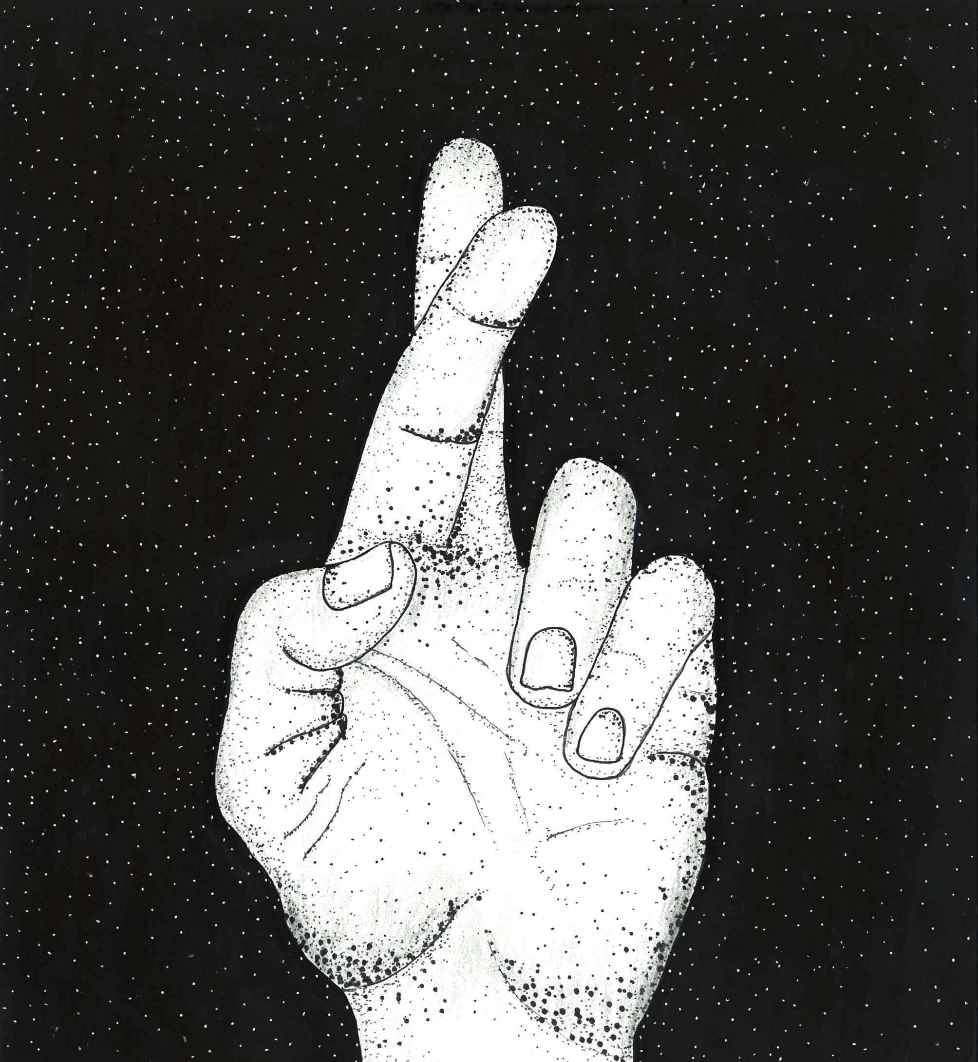

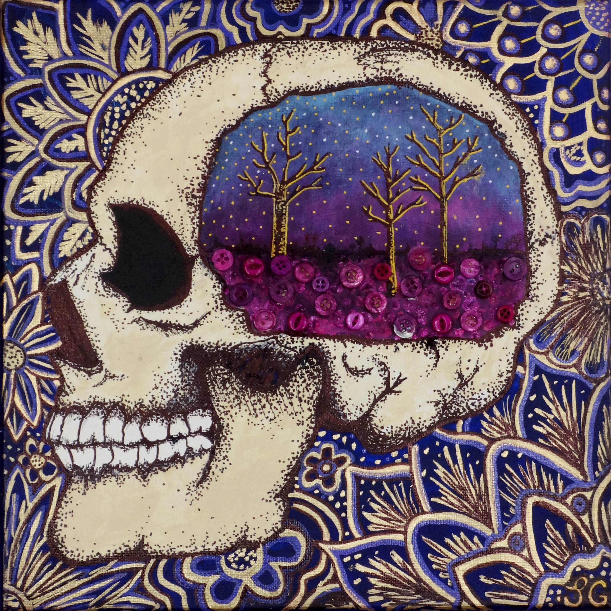

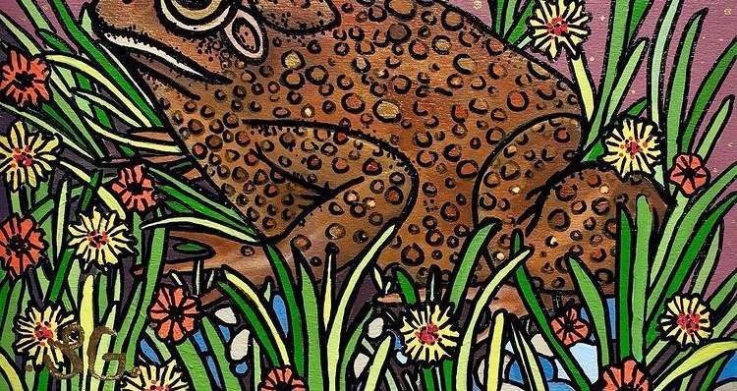
Laura-Leigh Gillard
Laura-Leigh Gillard
Notes:
COORDINATOR
Some of Laura-Leigh’s art, which is one of her methods of self-care. The participants will be reading Laura-Leigh’s story for homework.

Slide 22
Thank You
Notes:
TRAINER
Thank everyone for their time and ask if anyone has any final comments or questions that they want to bring forward.

